Slide 1
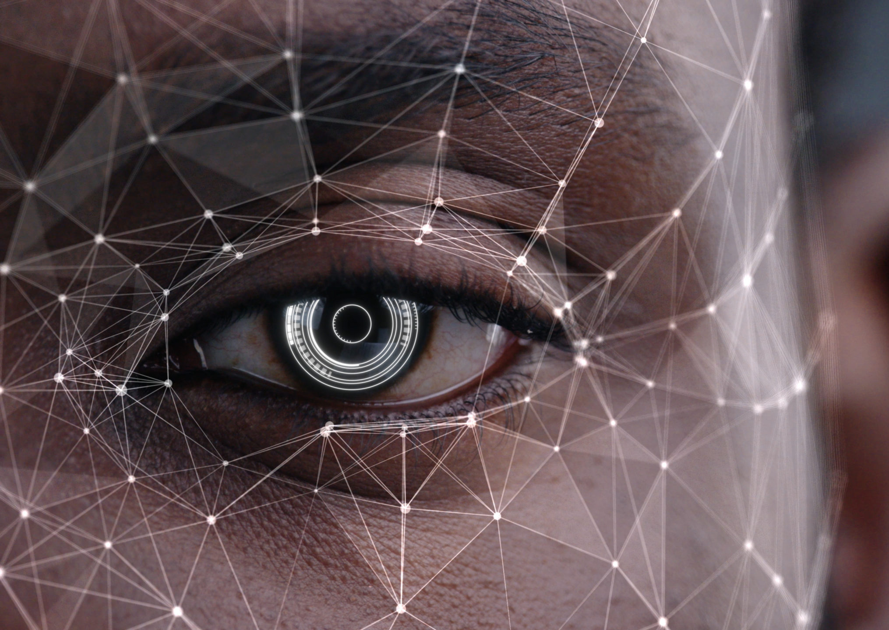
Face Recognition Data Analysis by Dhanush M
This Photo by Unknown author is licensed under CC BY.

Slide 2
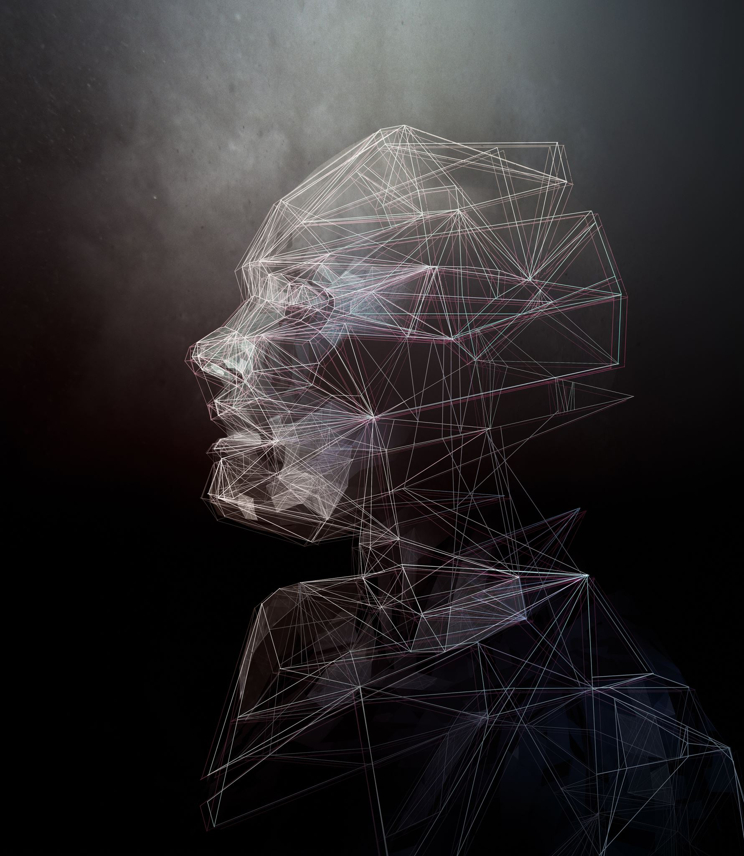
INTRODUCTION
Face recognition system is an application to verify a persons identity by comparing pictures taken recently from a digital camera or VCR , and
compare with the images stored in the system database.
Face recognition system has been widely used in recent years for security and access control,
like other security system that rely on biometrics such as fingerprint or eye IRIS

Slide 3

Objectives
In this project we create the Face recognition of PGDA28 class using opencv,keras/TenserFlow and Deep Learning
To create our Face recognition of PGDA28 , we trained a two – class model of Training set and validation set
We then took this Face recognition classifier and applied it to image by:
▸Detecting faces in images
▸Extracting each individual face

Slide 4
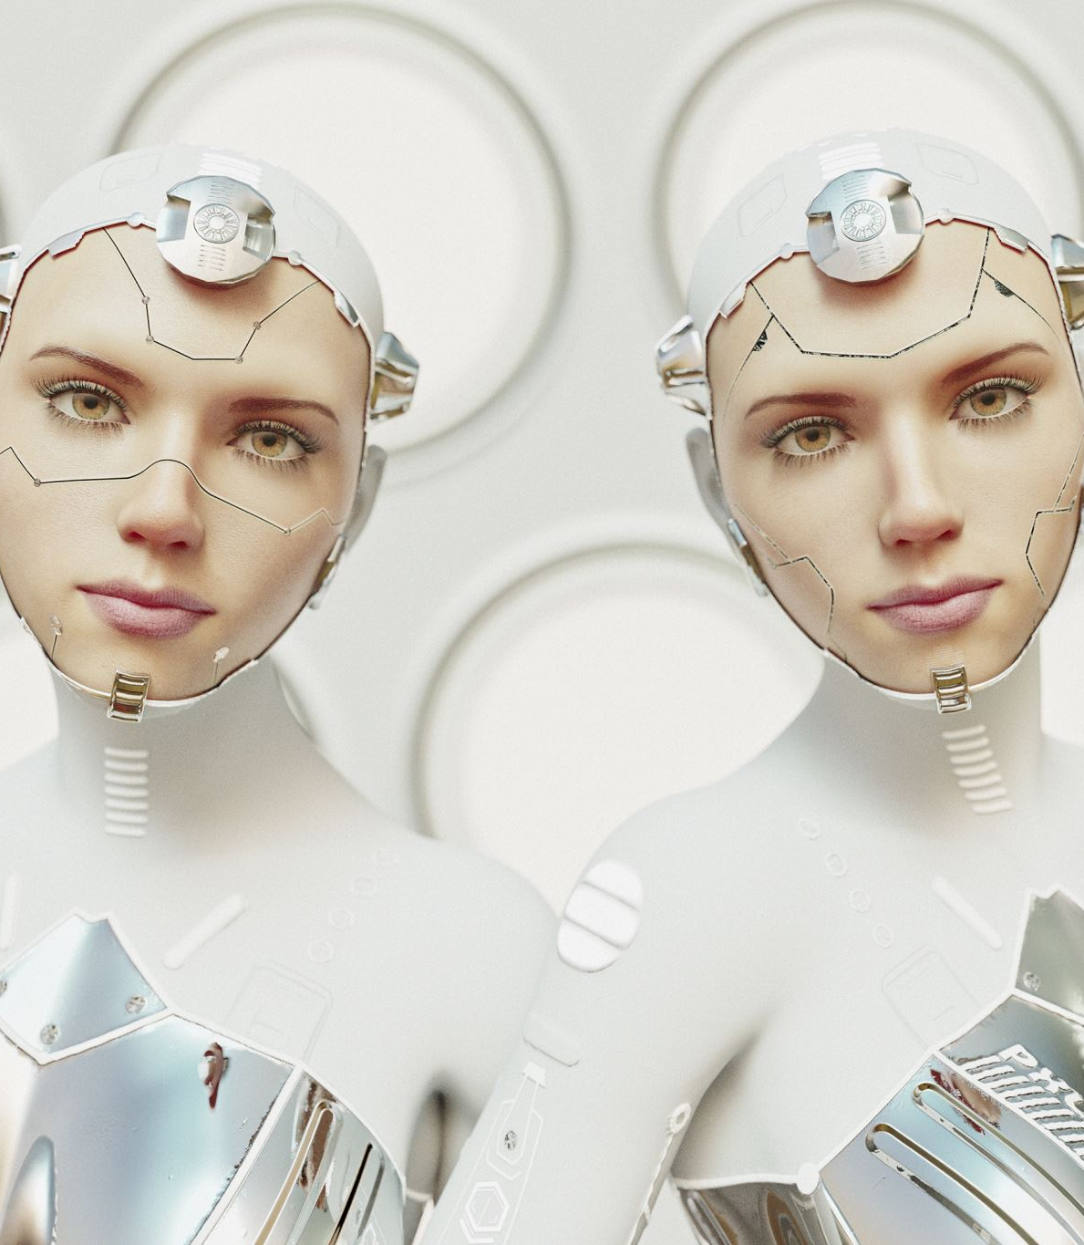
abstract
Face Recognition System
Description
Image and Generation
Building Model
Summary
Compiling and Executing Model
Repeating Same steps and Summary
Compiling and Executing model
Improvised Accuracy and loss base model
Conclusion

Slide 5
Face Recognition System
Face recognition system is an application to verify a persons identity by comparing pictures taken recently from a digital camera or VCR , and
compare with the images stored in the system database.
Face recognition system has been widely used in recent years for security and access control,
like other security system that rely on biometrics such as fingerprint or eye IRIS

Slide 6
Description
This dataset contains folders pertaining to different expressions of the human face, namely left side facing, right side facing, smiling, etc., The folders are split into two super-folders, Training and Testing(validation), so that it can become easier for the end user to configure any model using this data.
The training set consists of 200 samples in total with the testing set consisting of 50 samples in total. The data consists of 48x48 pixel colour images of faces. The faces have been automatically registered so that the face is more or less centred and occupies about the same amount of space in each image.

Slide 7
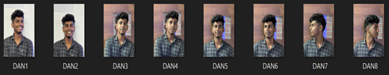


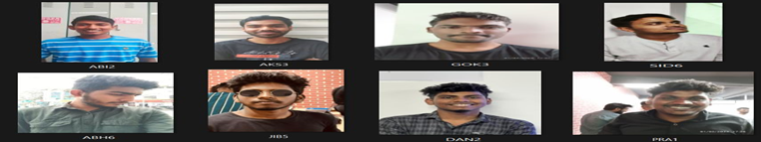
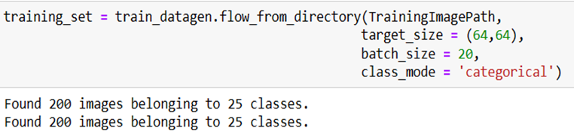
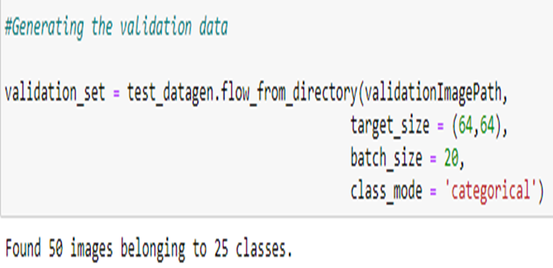


Images and Generation
Training image and Generation:
:
Validation image and Generation:

Slide 8
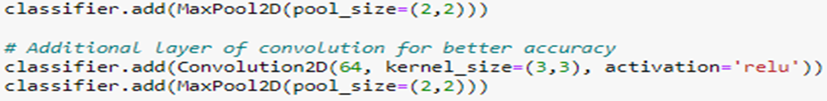
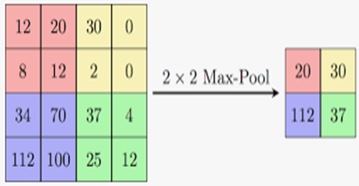

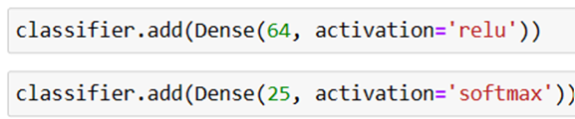
Building Model
Step 1: Convolution
Step 2: Max Pooling and Additional Layer of Convolution
Step 3: Flattening
Step 4: Fully Connected Neural Network

Slide 9
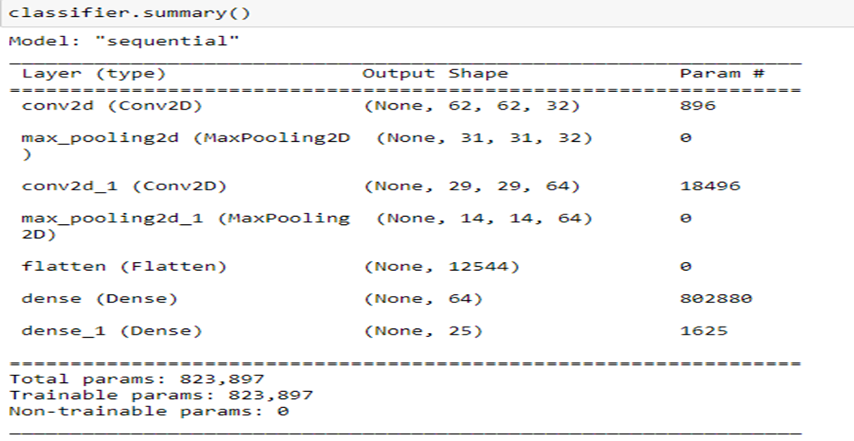
summary

Slide 10
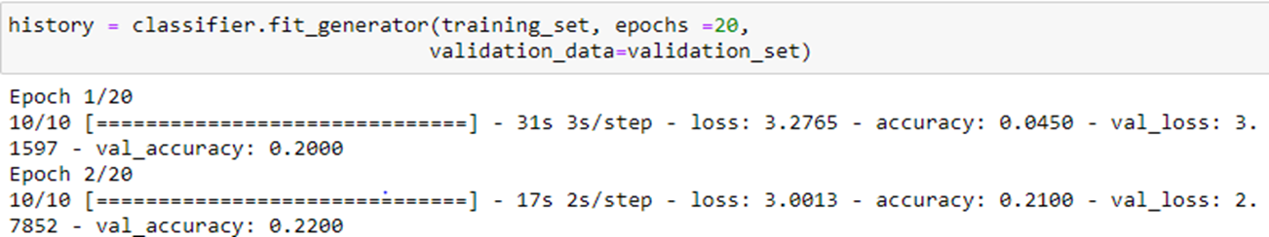
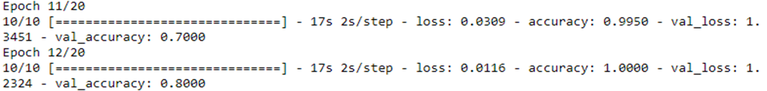
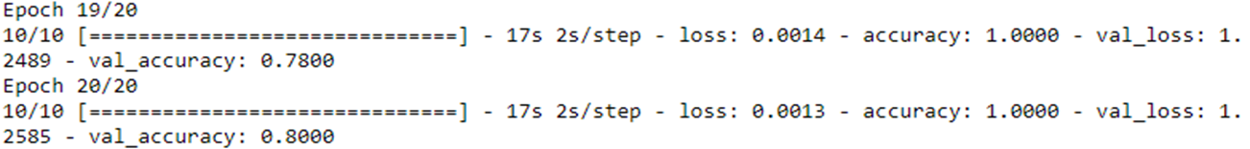
Compiling and Executing Model

Slide 11
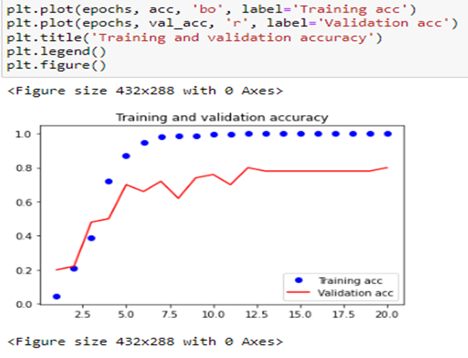
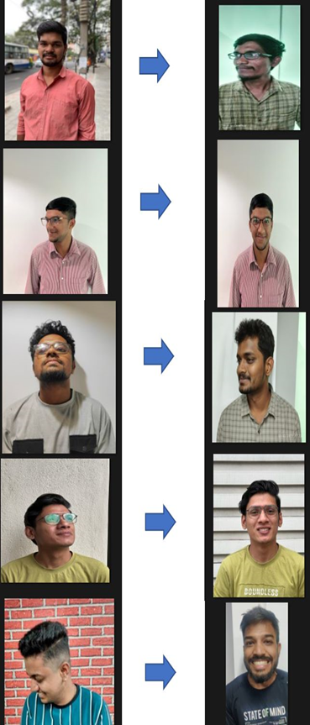
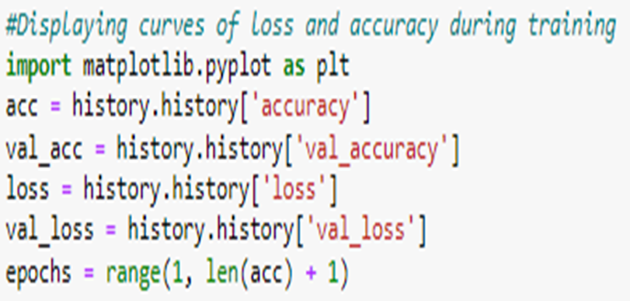
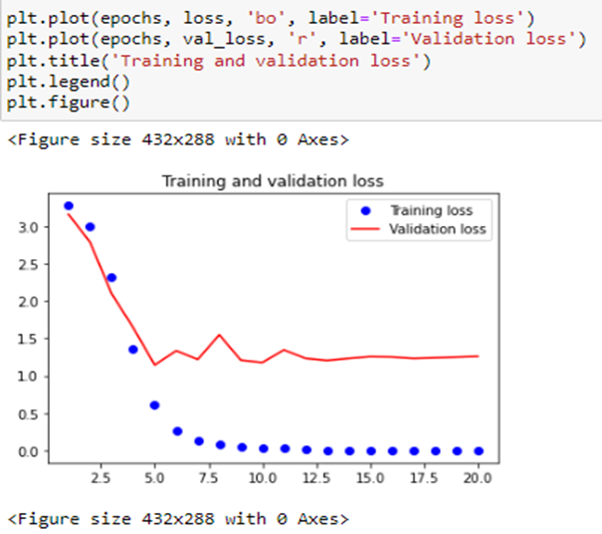
Accuracy and Loss Based Model

Slide 12
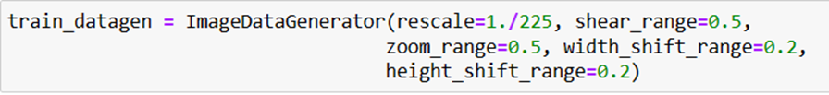
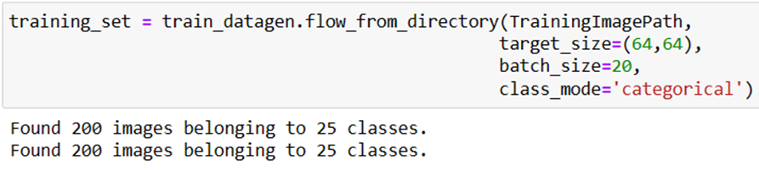
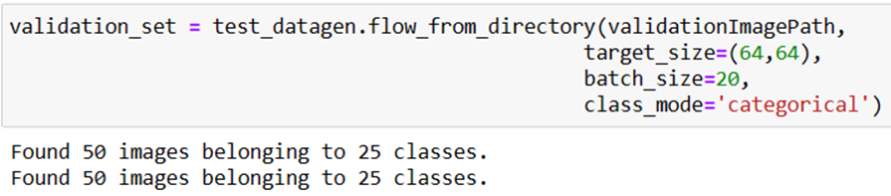
Improving Model
Improving model by Adding parameter to the image data generator
Generating Training Data and Validation Data

Slide 13
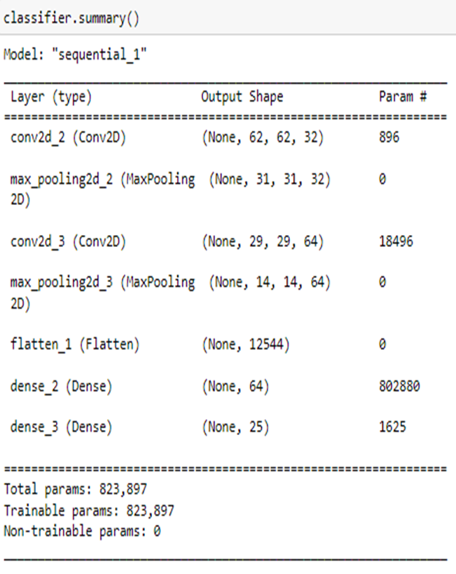
Repeating Same steps and Summary
Repeating the same step of building the model
1.Initializing the convolution neural network
2.Max Pooling and Additional convolution layer for accuracy
3.Flattening
4.Fully connected Neural Network

Slide 14
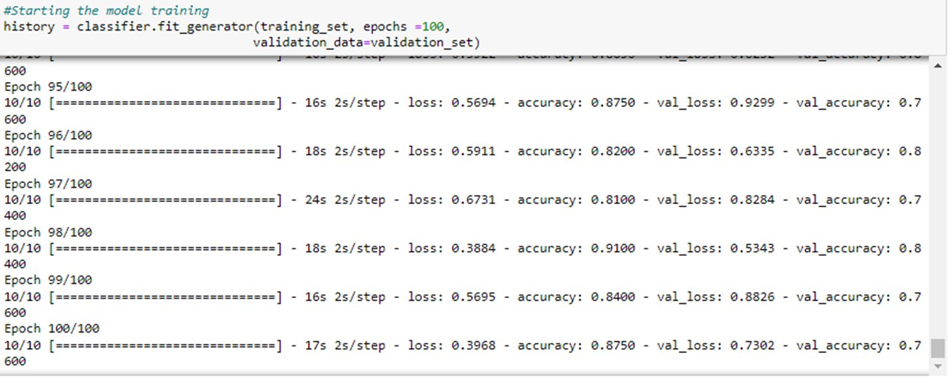
Compiling and Executing

Slide 15
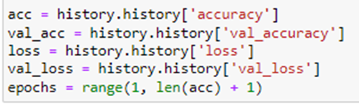
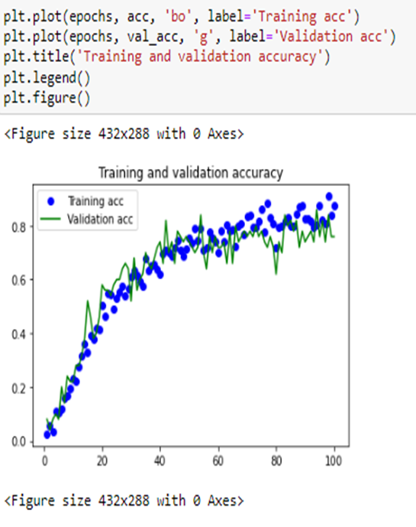
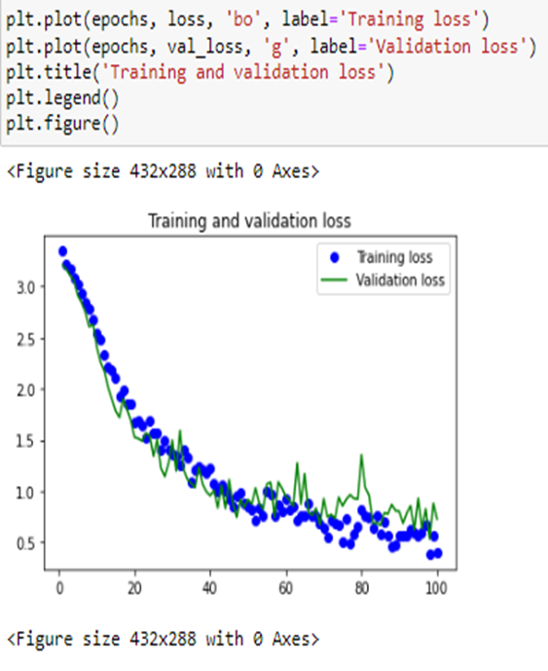
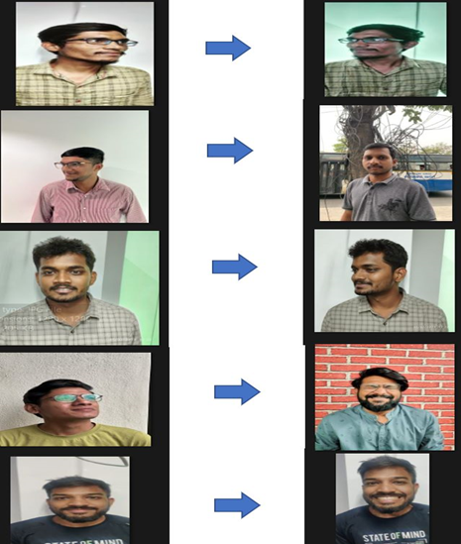
Improvised Accuracy and Loss base Model

Slide 16
Conclusion
Face recognition technology has come a long way in the last twenty years. Today, machines are able to automatically verify identity information for secure transactions, for surveillance and security tasks, and for access control to buildings etc. These applications usually work in controlled environments and recognition algorithms can take advantage of the environmental constraints to obtain high recognition accuracy. However, next generation face recognition systems are going to have widespread application in smart environments -- where computers and machines are more like helpful assistants.
To achieve this goal computers must be able to reliably identify nearby people in a manner that fits naturally within the pattern of normal human interactions. They must not require special interactions and must conform to human intuitions about when recognition is likely. This implies that future smart environments should use the same modalities as humans, and have approximately the same limitations. These goals now appear in reach -- however, substantial research remains to be done in making person recognition technology work reliably, in widely varying conditions using information from single or multiple modalities.

Slide 17

Thank You
This Photo by Unknown author is licensed under CC BY-NC.

